Slide 1
Renewing the Sectional Struggle
The American Pageant,
Chapter 18

Slide 2
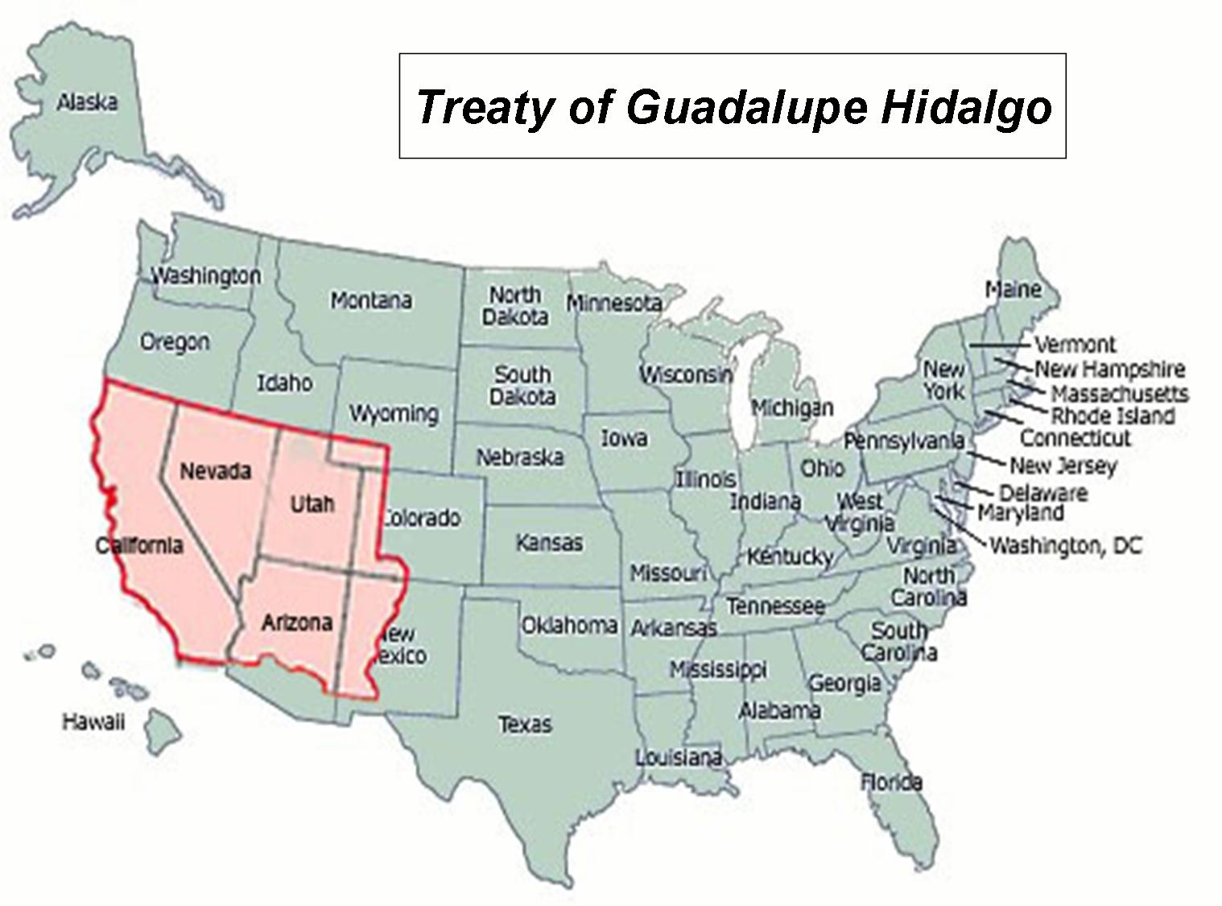
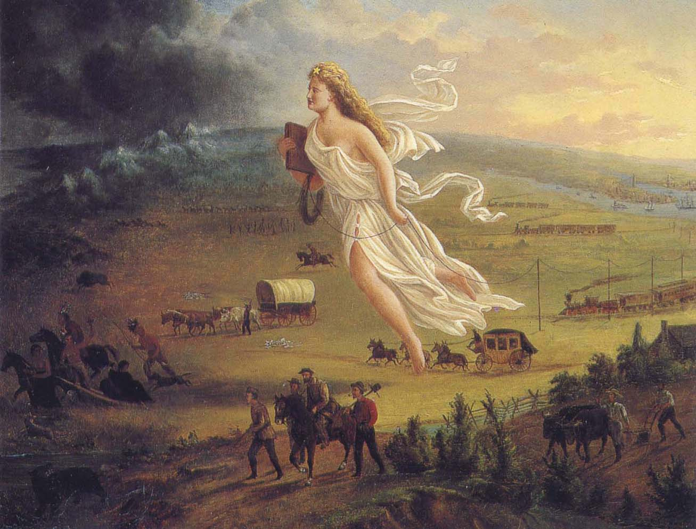
Quick Recap
Treaty of Guadalupe-Hidalgo
1848, Ends Mexican War
Manifest Destiny
California—gold discovered
Apply for statehood as a free state
Balance of power
New Territories
Big Question—Slavery!
Economy; States rights; Way of life
Abolitionists vs. Fire Eaters

Slide 3
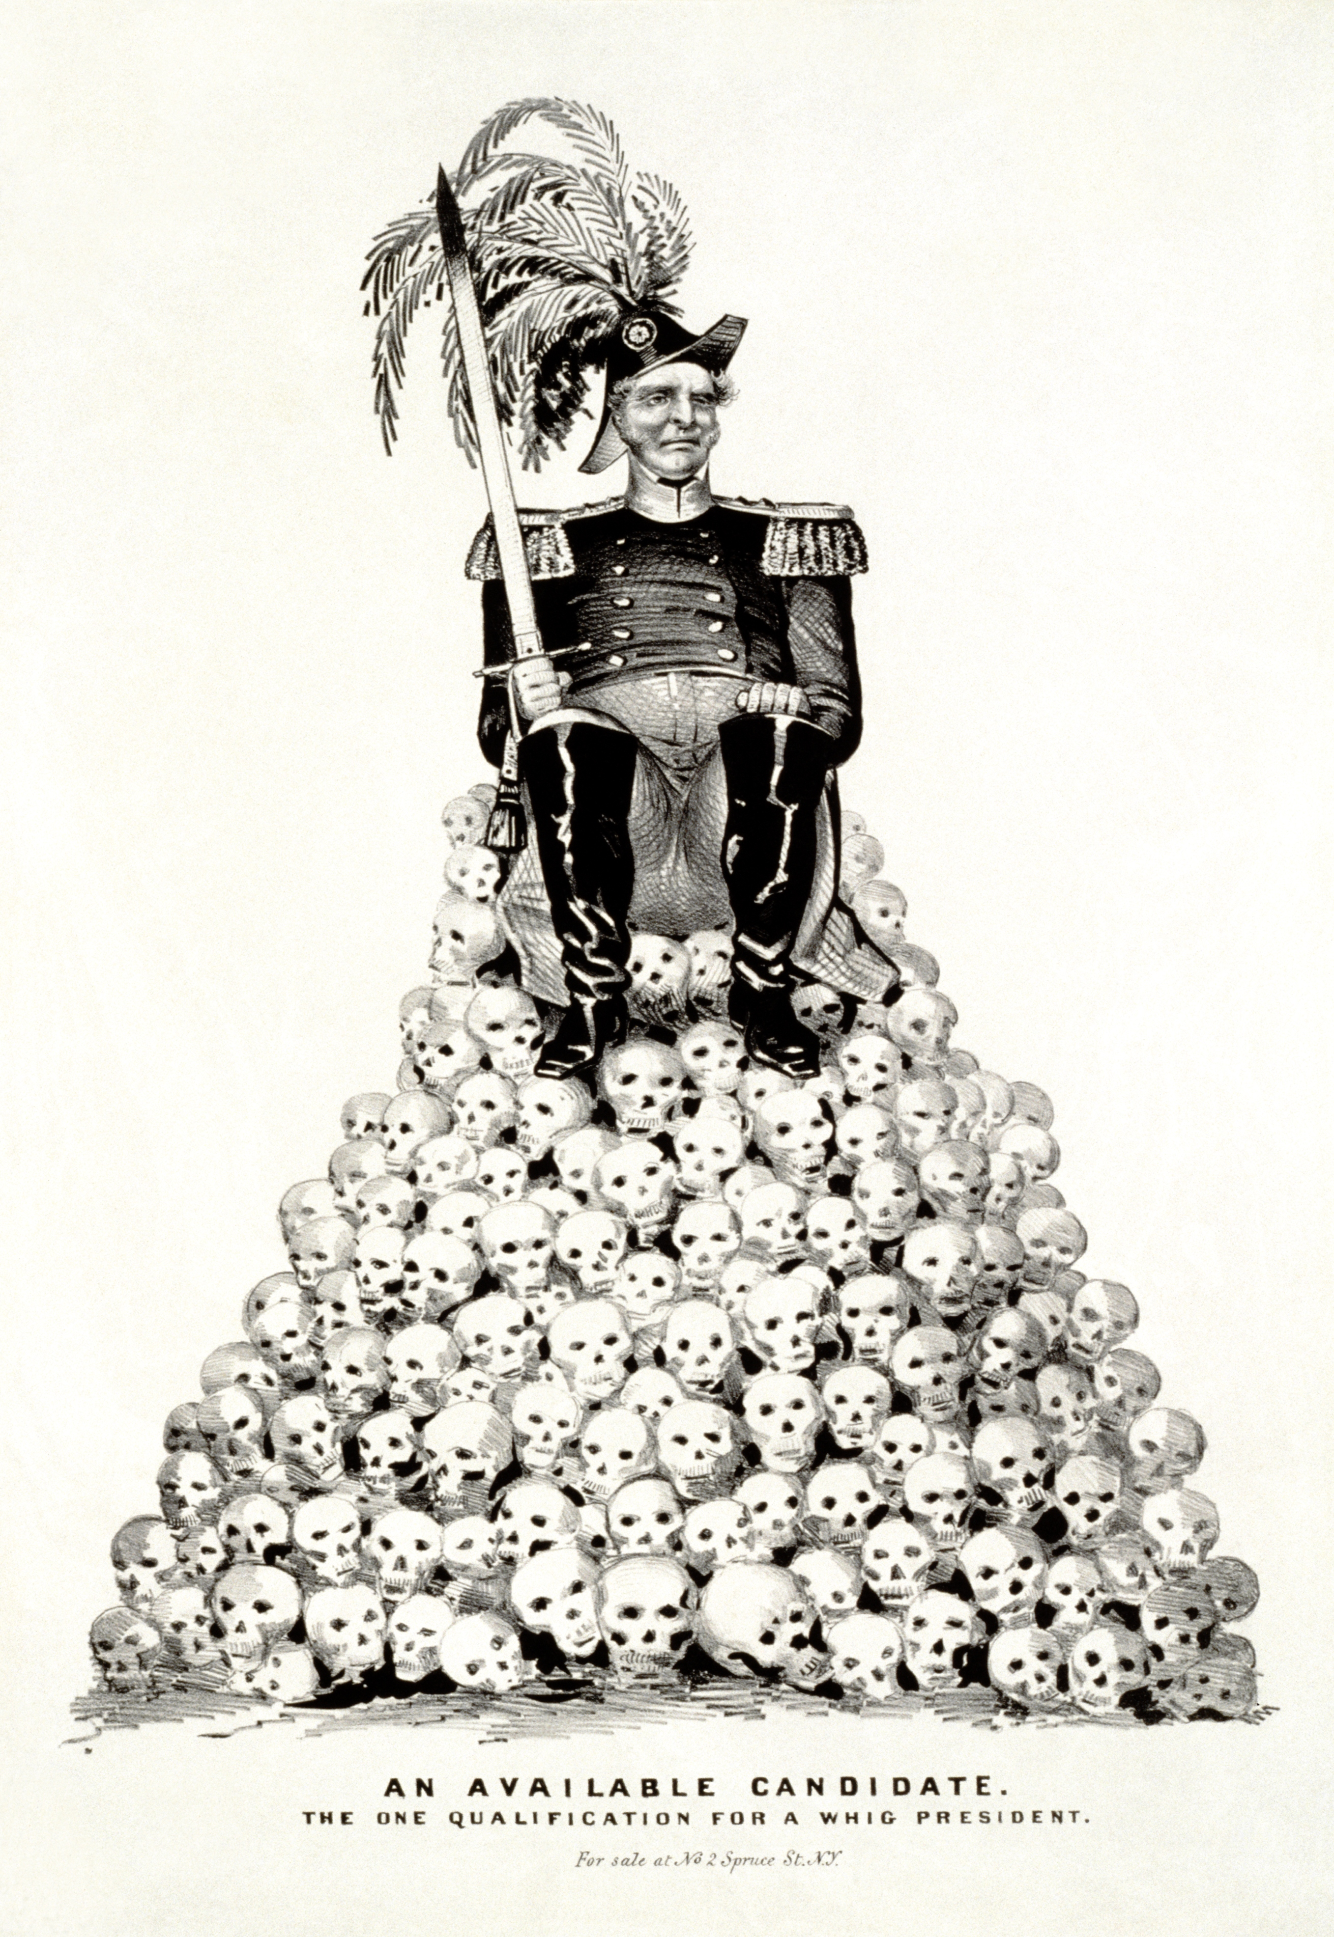
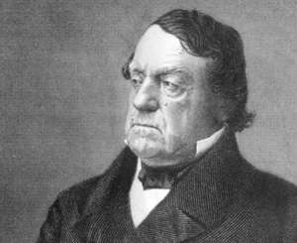
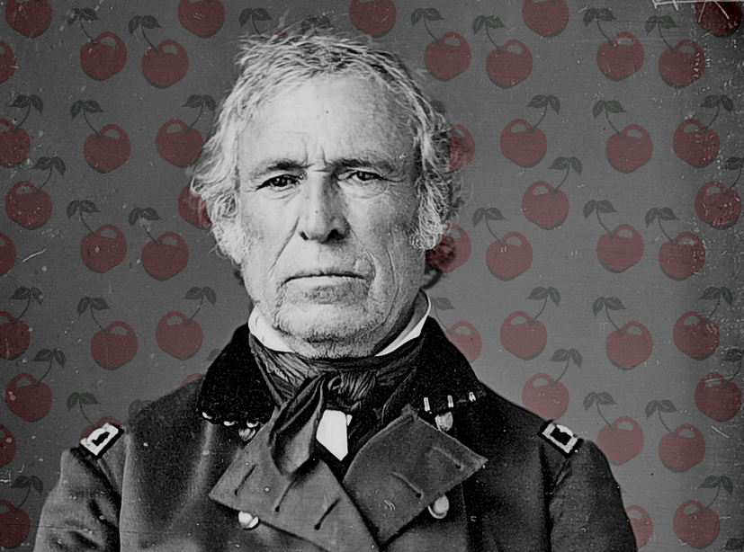
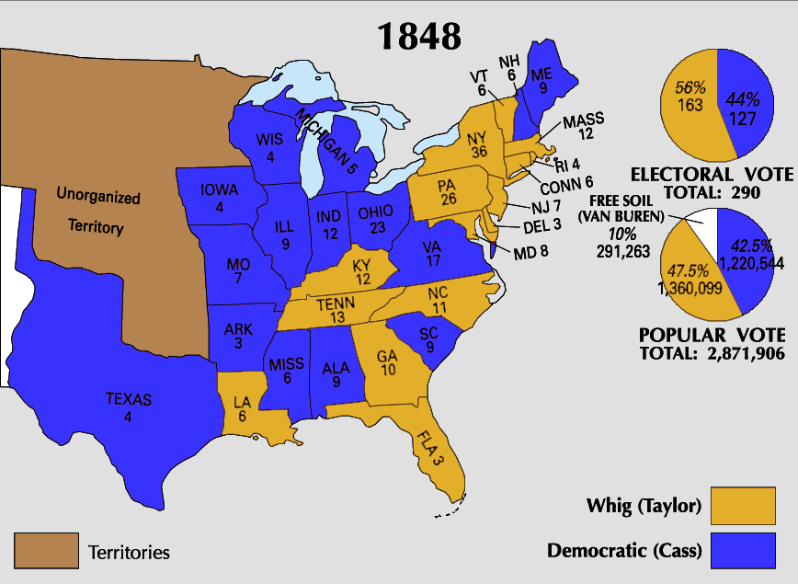
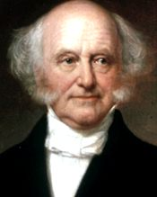
Kicking the Bucket Down The Road
Election of 1848
Polk opts out of running
Democrats turn to Lewis Cass
POPULAR SOVEREIGNTY
Appeals to people and congress
Whigs run with Zachary Taylor
War Hero
No verbal stance on slavery
New party—Free Soilers
Not anti-slavery
Advocate homesteading; government aid
Run with Martin Van Buren

Slide 4
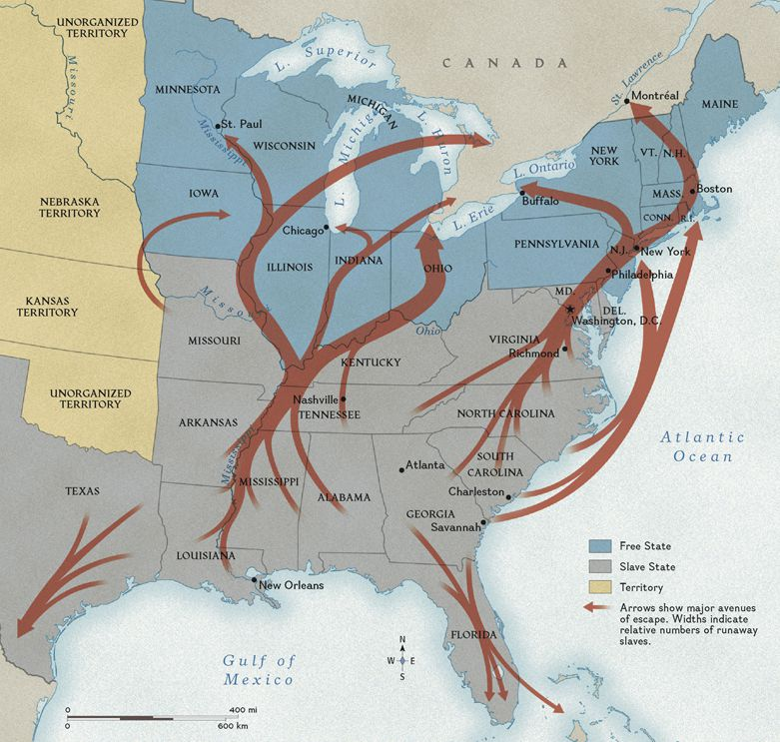
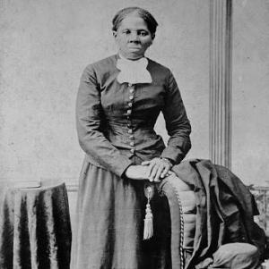
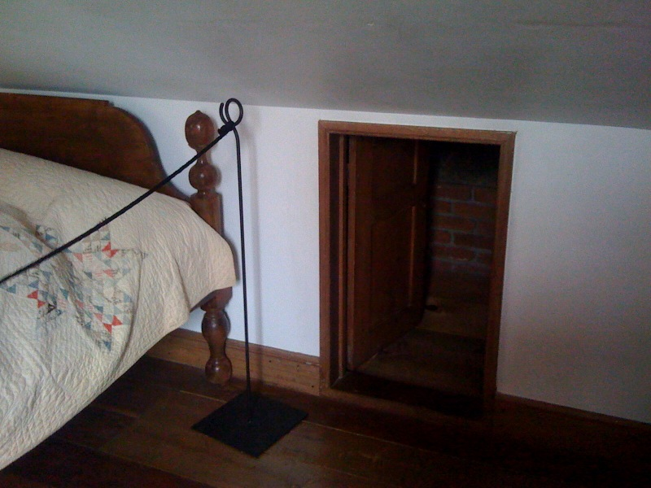
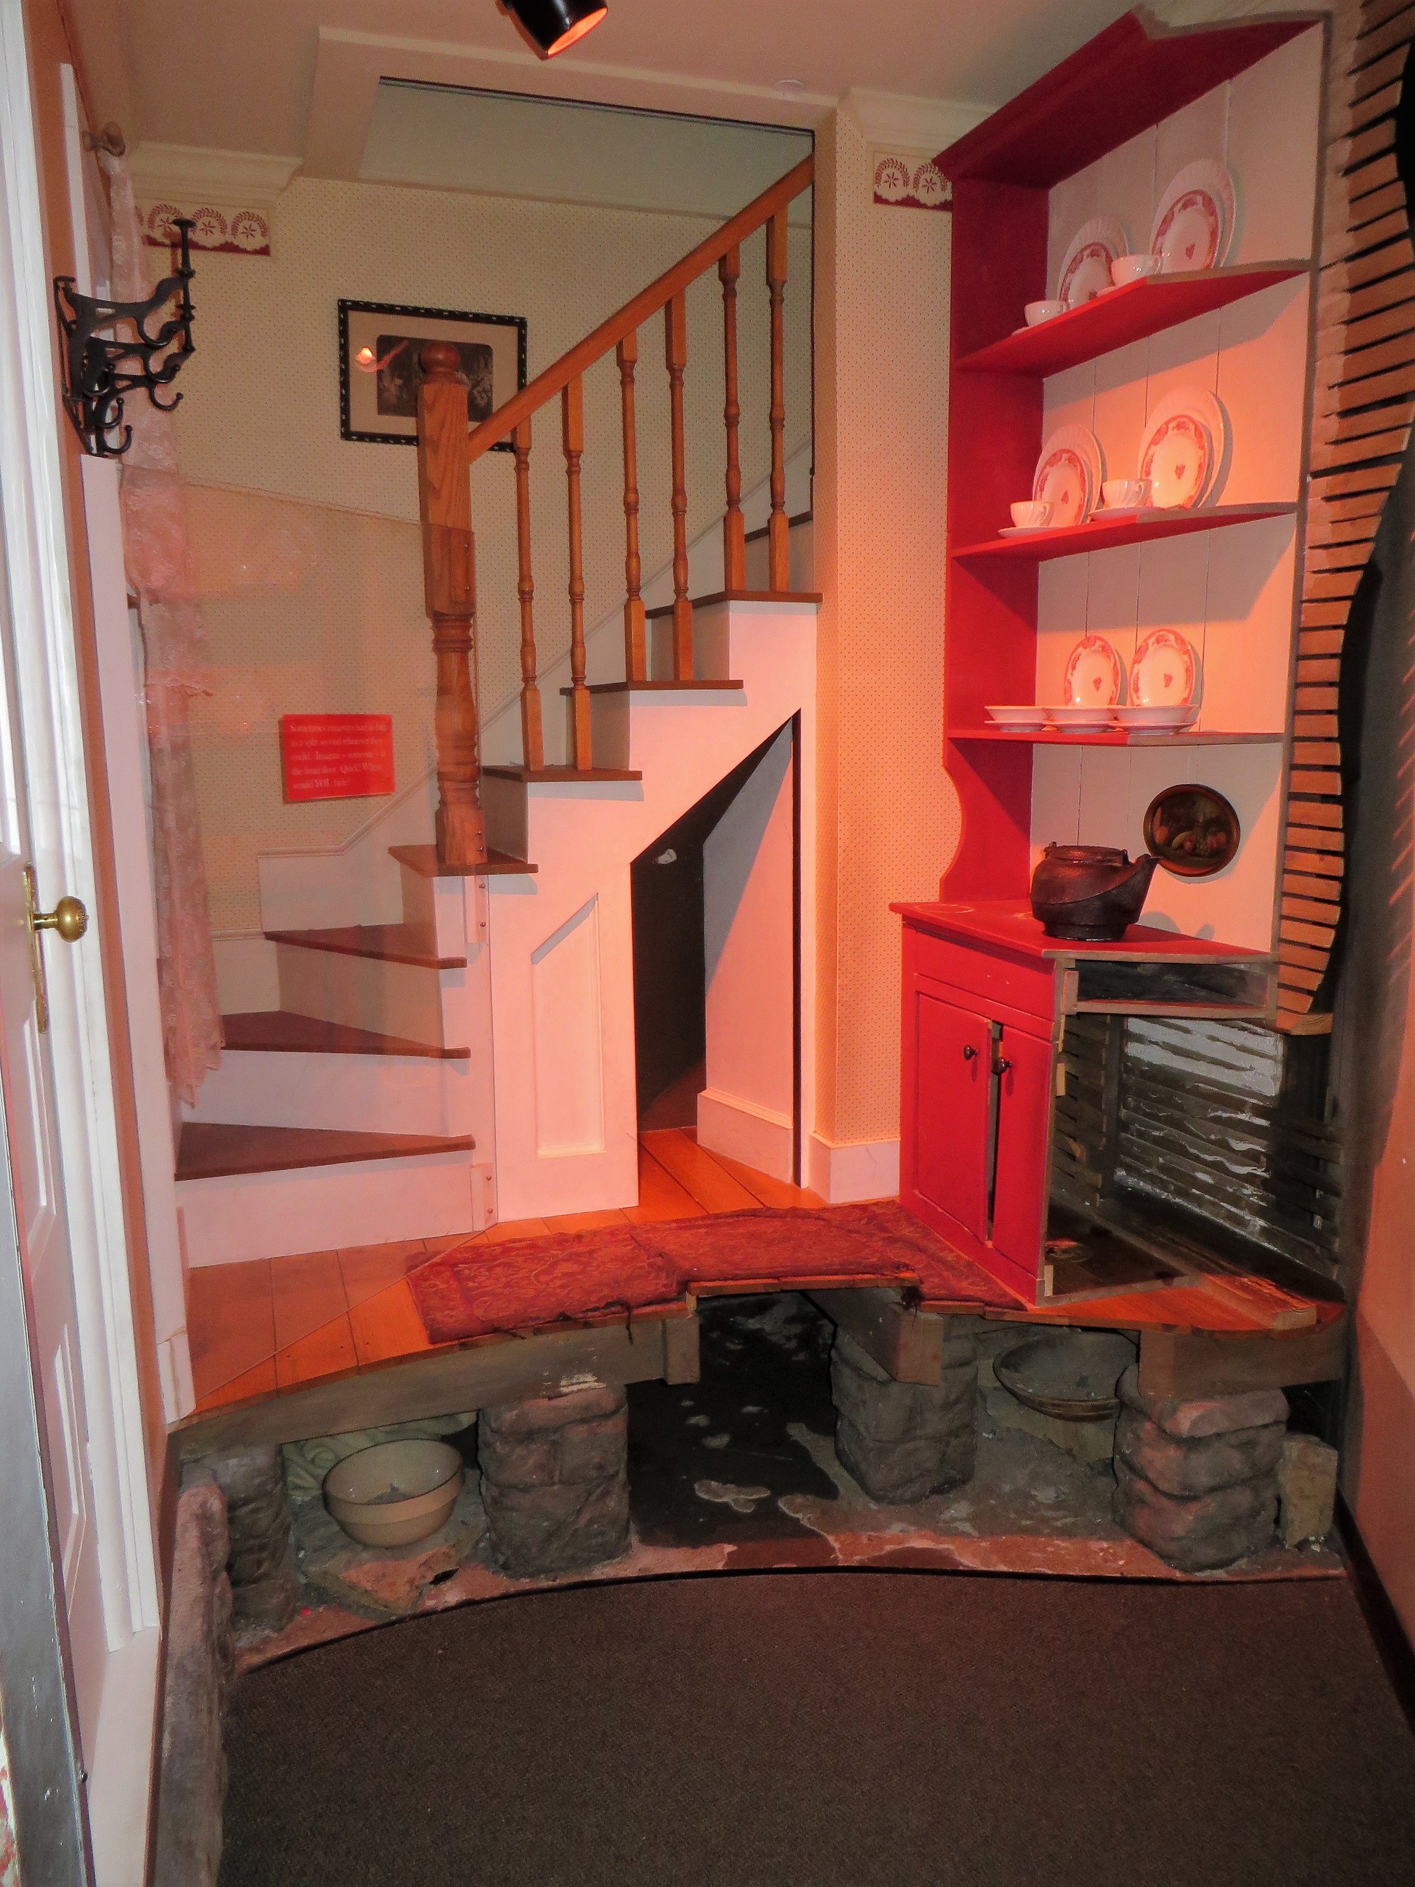
Underground Railroad
South well off
President
Majority of SCOTUS
Equal to North in Senate
Expansion of land/economy
Southern land questions
CA, NM, UT
TX territory in NM
Underground Railroad
Runaway slaves
Calls for a new Fugitive Slave Law
Threats of secession

Slide 5
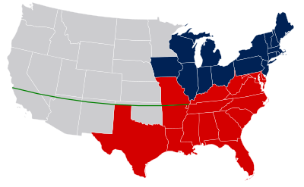
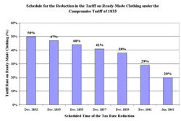
Can there be compromise?
Previous Compromises
Missouri Compromise
Nullification Crisis—Force Bill; Compromise Tariff

Slide 6
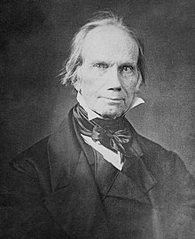
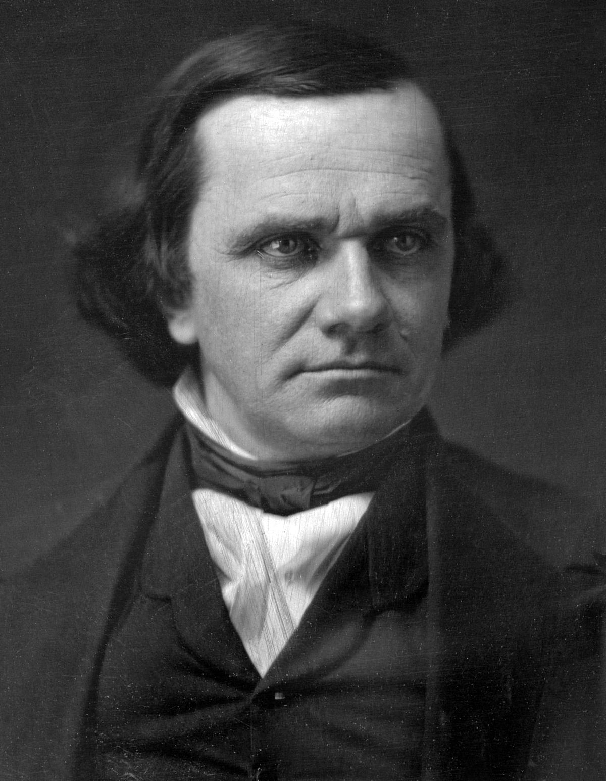
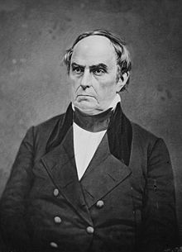
Debating Slavery
Henry Clay | Stephen Douglas | Daniel Webster
-“Great Compromiser” -Called for compromise from both sides -Requests North to make a fugitive slave law | -Speaks for three hours -Requests reasonable concessions be made by the North -Asks for a fugitive slave law | -Feels that it is “sacrilege” to rule on slavery as God already had through geography and topography -*Seventh of March Speech* ---Calls for reason, compromise, concession
“The Old Guard”

Slide 7
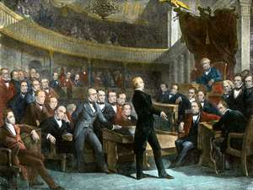
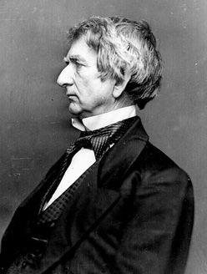
Debating Slavery
William Seward
-Anti-slavery -Against concession “Obey God’s moral law” “Higher law” than the Constitution
“The New Guard”

Slide 8
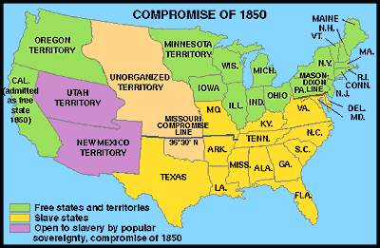
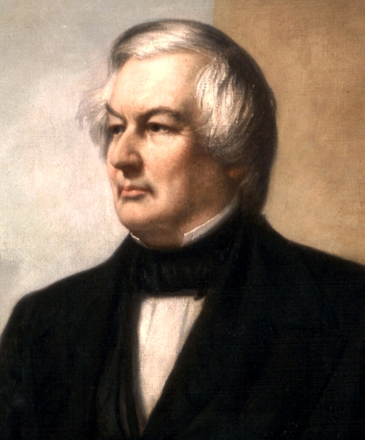
Compromise of 1850
No one really likes it because…
Compromise
But…
CA admitted as free state
NM / UT left to pop. Sovereignty
Bans slave trade in DC
Fugitive Slave Law for South
Settles border dispute between TX NM
TX debt partially paid off
Fillmore—new president
“Final settlement” of division

Slide 10
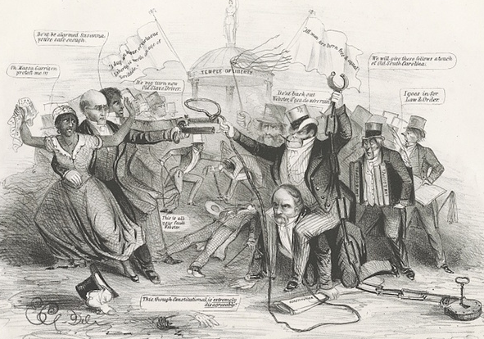
Calm before the storm
Fugitive Slave Act of 1850—increased sectionalism
North is a “hunting ground” for runaways
Northerners arrested for harboring slaves
Freed Blacks not given fair trials
Bribery within court system over runaway cases
Some northern states fight back
MA—nullification
“Personal liberty” laws
More and more northerners on board with fighting
As time goes on, industrial North builds up
Time---MATTERS!

Slide 11
Slavery from Revolution to Civil War

Slide 12
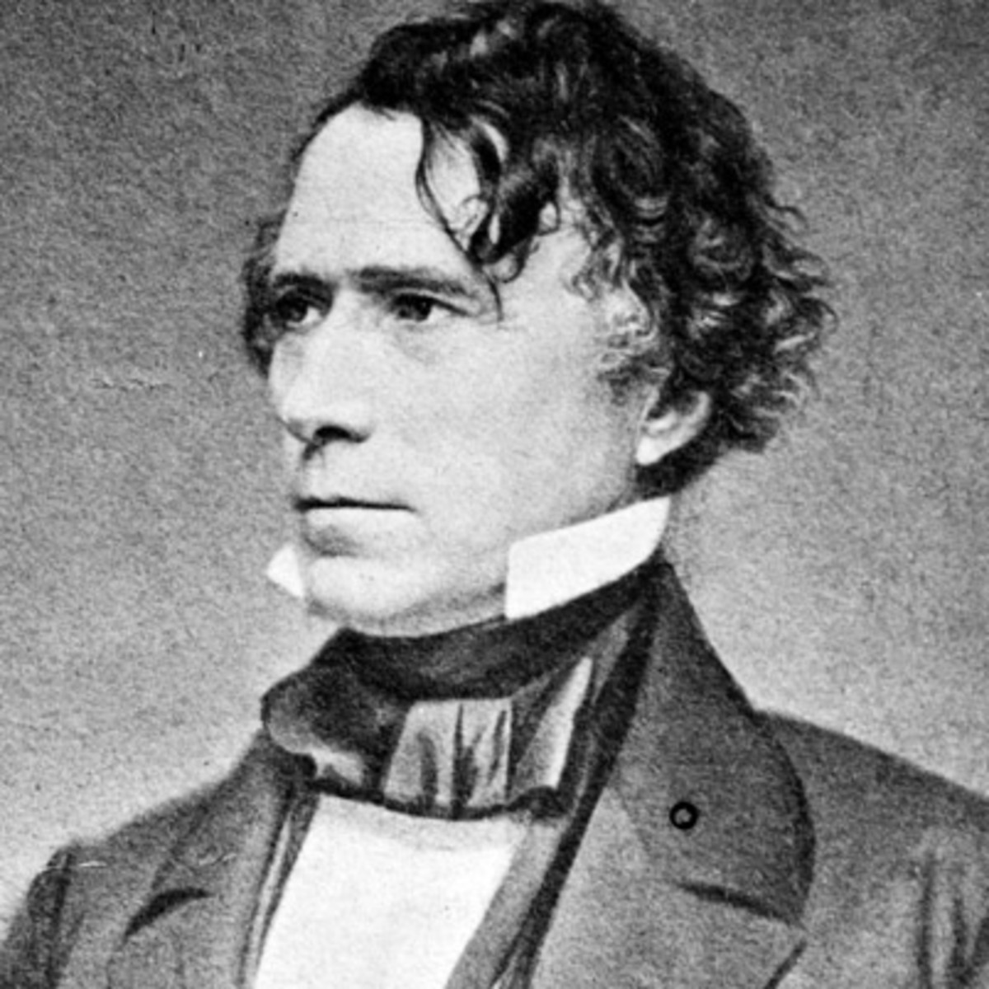
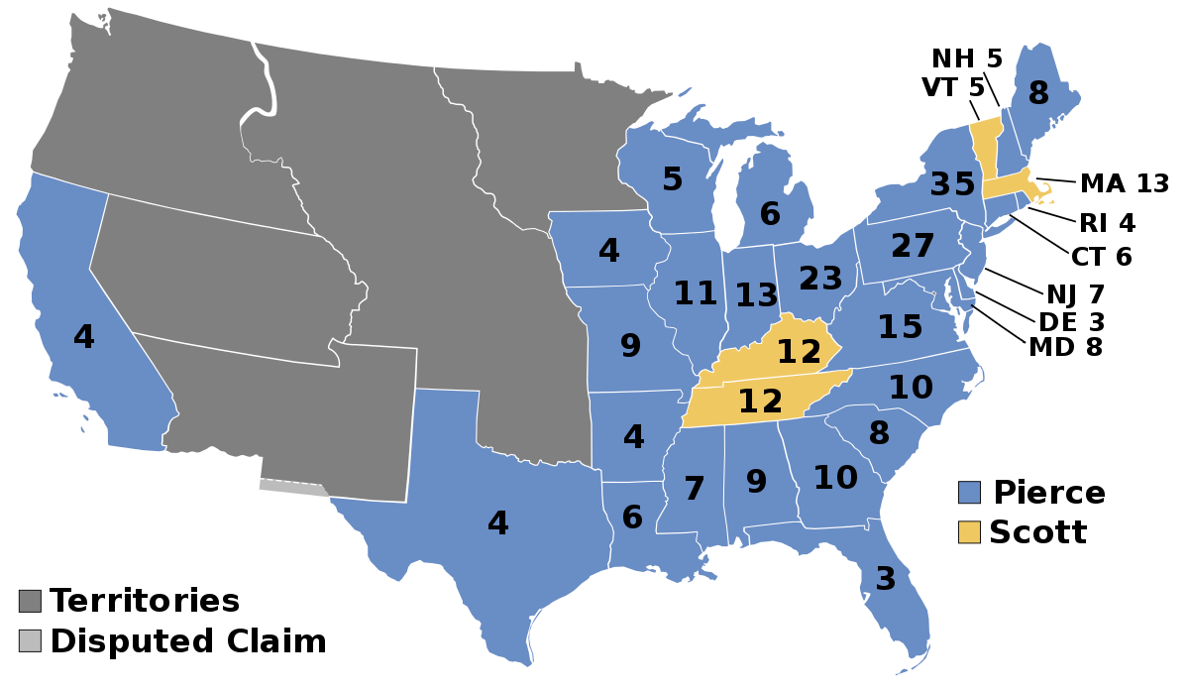
Election of 1852
Democrats run with Franklin Pierce
Dark Horse
Mexican War veteran
Whigs lose
Division over slavery; fugitive slave laws

Slide 13
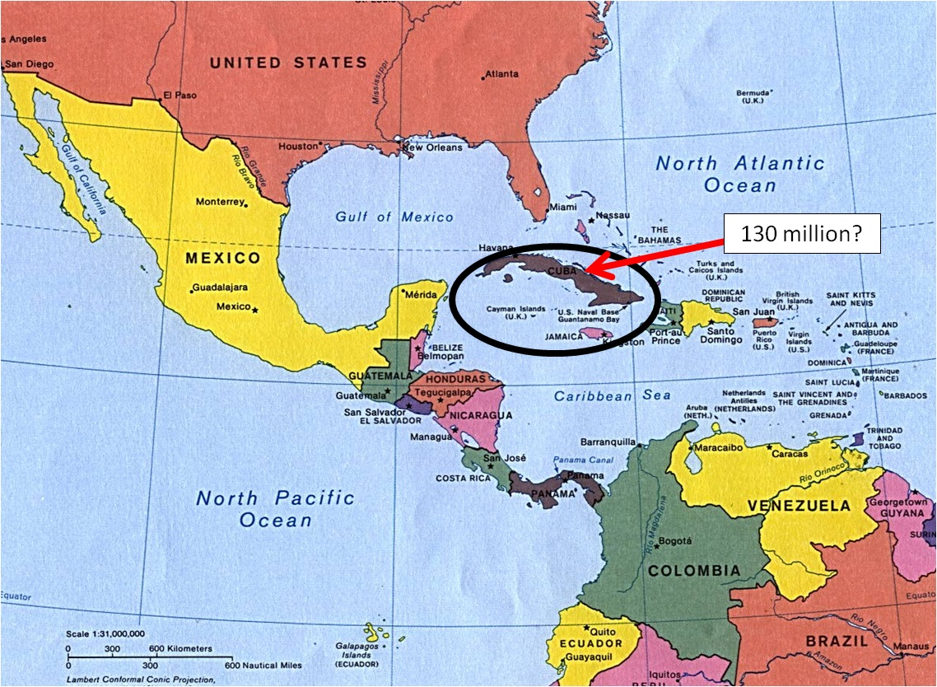
A Few Odds and Ends
1850
Clayton-Bulwer Treaty
Concern over British presence in the hemisphere
Agreement that neither US nor Britain would control isthmian waterways
Upsets south—more territory (expansion and power) for them—gone!
1854
Ostend Manifesto
Attempt to purchase Cuba from Spain
Upsets North
Plan falls through
“Slaveocracy”
Establish better relations (trade, commerce, treatment, etc.) with China and Japan (Wanghia; Kanagawa Treaties, respectively)

Slide 14
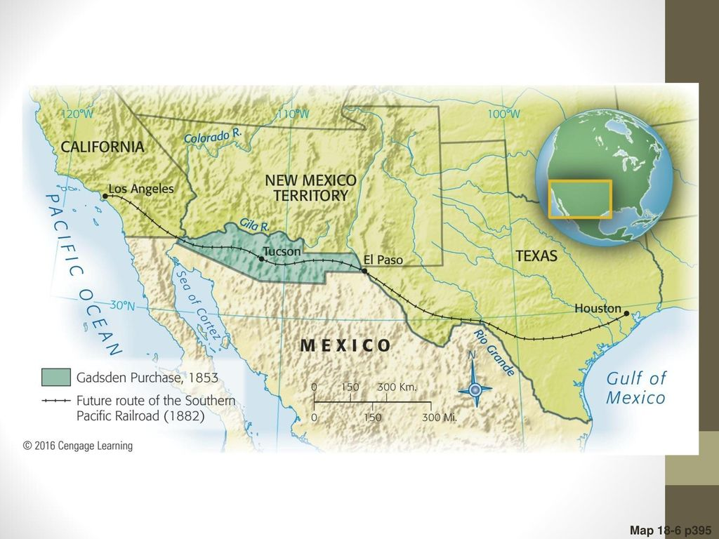
Gadsden Purchase
Transportation issues
North and South want a RR
Too expensive to build more than one
Purchase additional territory from Mexico for $10,000,000
North upset
South—it makes sense to build here!

Slide 15
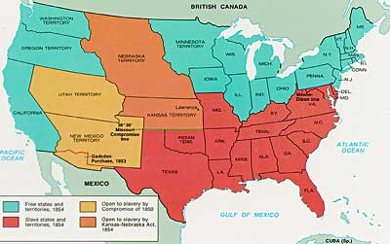
KANSAS-NEBRASKA ACT—1854
Stephen Douglas
Northern Democrat
Wants RR in Illinois out west
Wants westward push
South will go against
To get Southern approval…
Establish two territories (Kansas, Nebraska)
Slavery issue decided by popular sovereignty (K, Na)
Problem—this plan repeals the Missouri Compromise
Slavery can expand North!
Death of Whigs; Birth of Republicans

